Slide 1


Flex 4 - Spark Containers
Ryan Frishberg
Software Consultant, Lab49
http://www.frishy.com

Slide 2
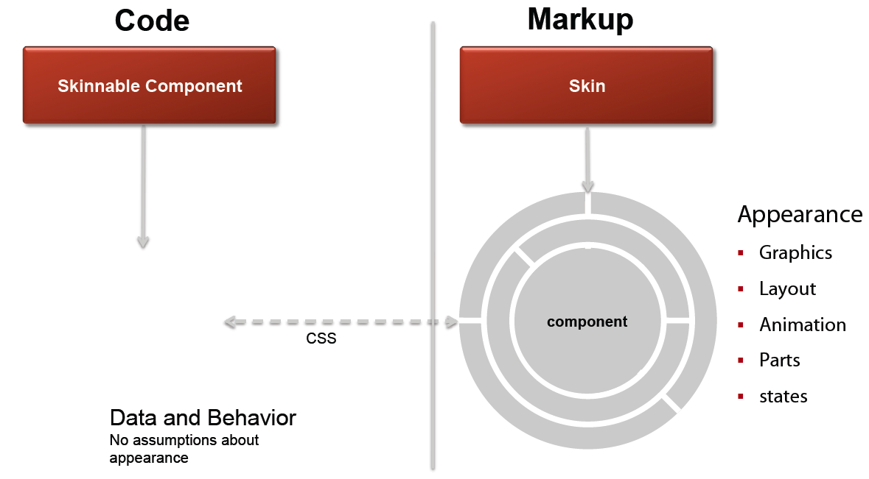
Spark Architecture

Slide 3
From MX to Spark
MX
  Rich, styleable components
  Heavy components => Easy to use (most of the time)
Spark introduces new component model
  Declarative Skins - rich, toolable, extremely customizable but heavier than MX
  Lightweight graphic primitives (MXML Graphics)
  Lighter-weight modularized components

Slide 4
Spark Containers
A container is a component used to size and position other components
What’s different in Spark?
  More container classes
  Assignable layouts
  Supports non-UIComponent children

Slide 5
Types of Spark Containers
UIComponent
GroupBase
SkinnableComponent
Group
DataGroup
SkinnableContainerBase
Scroller
HGroup
VGroup
ItemRenderer
SkinnableDataContainer
SkinnableContainer
List
Panel
BorderContainer
…
- Baseclass
- Viewport container
- Data containers
- “Regular” containers
* Some simplification has been done on the diagram
** Not pictured: ContainerMovieClip, TileGroup, or MX Containers

Slide 6
Group Basics
Group is the main container class in Spark for holding visual elements
Differences with MX Container:
  Swappable layouts
  Chromeless
  No scrollbars
  No deferred instantiation

Slide 7
Assignable Layouts
How a component is sized and positioned is now deferred to a separate layout object
Layout objects must extend LayoutBase
Examples:
  BasicLayout
  VerticalLayout
  HorizontalLayout
  ScrollerLayout
  ConstraintLayout (4.5)
  FormItemLayout (4.5)
  ….

Slide 8
What can containers hold?
Visual Elements: Anything that implements IVisualElement (and ILayoutElement)
  UIComponent
  GraphicElement
  SpriteVisualElement
  UIMovieClip
  StyleableTextField (Flex 4.5 only)
DataGroup can hold data items (basically anything)
  Item renderer must be able to convert it to an IVisualElement AND a DisplayObject

Slide 9
UIComponent vs GraphicElement vs. Compiled FXG
UIComponent
heavy, but they add convenience
GraphicElement
Light-weight drawing primitives
FXG
Static vector graphics

Slide 10
Example of Runtime Graphic Elements in MXML
MainApplication.mxml
application.mxmlContent = [createButton1(), createRect1(), …]
function createButton1():Button {
var btn:Button = new Button();
btn.label = “Hello World”;
btn.x = 5;
…. return btn;
}
function createRect1():Rect {
var rect:Rect = new Rect();
rect.id = “myRect1”;
rect.fill = createSolidColorFill1();
…. return rect;
}
function createSolidColor1():SolidColor {
var sc:SolidColor = new SolidColor();
sc.color = 0x00FF00;
return sc;
}
<s:Application xmlns:fx="http://ns.adobe.com/mxml/2009"
xmlns:s="library://ns.adobe.com/flex/spark">
<s:Button label="Hello World" x="150"/>
<s:Rect id="myRect1" width="100" height="100">
<s:fill><s:SolidColor color="#FF0000" /></s:fill>
</s:Rect>
<s:Rect id="myRect2" width="100" height="100" x="20" y="20">
<s:fill><s:SolidColor color="#00FF00" /></s:fill>
</s:Rect>
<s:Rect id="myRect3" width="100" height="100" x=”40" y=”40">
<s:fill><s:SolidColor color="#0000FF" /></s:fill>
</s:Rect>
</s:Application>
Translated into
ActionScript by
the MXML compiler
Notes:
Let’s take a look at what these GraphicElements look like in code. Here we have an example of a simple Hello World type application that has three Rect primitives in it.
You can see that you can define properties on those rects like width and height and fill color, etc. GraphicElements are very flexible you can change them individually at runtime, use data binding with them, and use the normal spark layout features like % sizing and top/left/bottom/right constraints.

Slide 11
Runtime GraphicElements Share DisplayObjects

Slide 12
Example of Compiler Optimized FXG
MainApplication.mxml
MyGraphic.fxg
<s:Application ...
xmlns:assets="*">
<s:Button
label="Hello World"
x=“150" />
<assets:MyGraphic />
</s:Application>
<Graphic xmlns="http://ns.adobe.com/fxg/2008">
<Rect width="100" height="100">
<fill>
<SolidColor color="#FF0000" />
</fill>
</Rect>
<Rect width="100” ... x="20" y="20">
<fill>
<SolidColor color="#00FF00" />
</fill>
</Rect>
<Rect width="100" ... x="20" y="20">
<fill>
<SolidColor color="#0000FF" />
</fill>
</Rect>
</Graphic>
Let’s take a look at the SWFDump Output
Notes:
Now if we look at a sample application using FXG. FXG is defined in a separate dot FXG file (as shown here on the left). On the right we see our main application again, but instead of having three Rects in it it has a single FXG asset. Notice that it looks a lot like a custom component or a (TODO: Evtim what was that other thing?).
Since dot FXG files are optimized at compile time into low level commands that the Flash Player can recognize, we can’t actually reference or modify any of the individual shapes that make up that Graphic at runtime (TODO: mention that they don’t exist any more, the compiler turned them into lower level commands, no actionscript exists for them any more?). We’re able to change properties on the FXG object as a whole at runtime, but we can’t tweak the Rect’s inside of it.
You can almost think of an FXG file like a JPG or PNG bitmap image. If you have a JPG of a company logo, you can always change the size and rotation of that logo as a whole, but you don’t have the ability to drill down and change the individual shapes that make up that logo. The same goes for FXG files.
However there is an important difference between a bitmap image like a PNG or JPG and an FXG file. Instead of storing bitmap data, the shapes in the FXG file are stored as vector information.
This means that the FXG file won’t lose quality when it is scaled to different sizes.

Slide 13
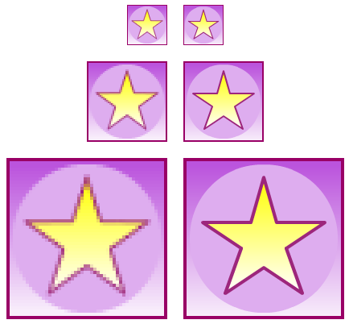
FXG Scaling Fidelity
JPG
<s:Image source="MyStar.jpg" />
FXG
<assets:MyStar />
width=50
width=100
width=200
Notes:
In Creative Suite 5 graphical tools like Fireworks and Illustrator now have the ability to export FXG files just like any other file formats they support.
So I created this pretty vector graphic in Fireworks and exported it as both a JPG and an FXG file. The dimensions of my source file was 50pixels by 50 pixels
I then placed those two different files into a Flex application to compare what they look like at different sizes. Here you can see at its natural size of 50x50, both the JPG and the PNG look identical.
But as I start to increase the width/height of the two components to 100 by 100 we start to see that the JPG starts to look a little bit jagged and the FXG file still looks nice and sharp.
It’s even more apparent the bigger we size things so here I set the width/height of the two components to 200 by 200 and the JPG fidelity loss is quite noticeable while the FXG still maintains its sharp vector graphics.

Slide 14
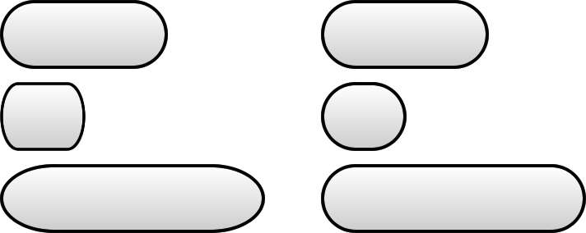
ScaleGrid in FXG
Without scale grid
With scale grid
Original Size
Scaled down
Scaled up
<s:Graphic xmlns="http://ns.adobe.com/fxg/2008"
viewWidth="100" viewHeight="60"
scaleGridLeft="20" scaleGridRight="80"
scaleGridTop=“0" scaleGridBottom=“0">
Notes:
To go along with the high fidelity scaling, FXG also provides support for scale grids.
Scale grids are used as a way of controlling what areas of the graphic should be scaled. So for example if you have a graphic that has rounded corners you might not want the whole graphic to scale uniformly. This can lead to squishing and stretching of the nice rounded corners as we see here.
In an FXG file you can specify the scale grid properties to designate where the corners are. That means that the whole graphic is scaled except for the areas in the corners.
Here we see as the size of the Graphic is scaled the corners stay nice and clean.

Slide 15
UIComponent vs GraphicElement vs. Compiled FXG
UIComponents are heavy, but they add convenience
GraphicElements are light-weight drawing primitives
  Modifiable at runtime
  Can draw into shared DisplayObjects
    Can’t share DisplayObject under certain scenarios
      alpha, blendMode, rotation, scale, filters
      Set alpha on the fill instead of the GraphicElement
    Beware of oversharing a DisplayObject
Compiled FXG are static vector graphics
  FXG is a subset of MXML
  Static – no event handlers, binding, styles, layout, etc…
  Optimized by the compiler

Slide 16
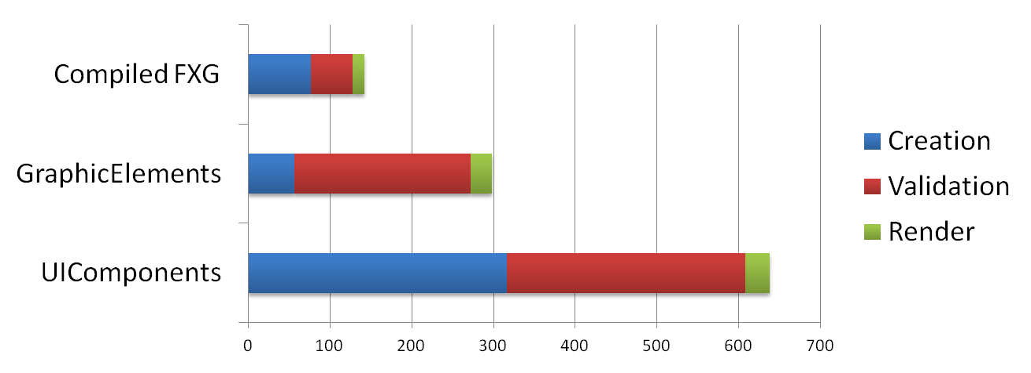
UIComponent vs GraphicElement vs. Compiled FXG
Use compiled FXG when you don’t need to modify the object at runtime
Use runtime GraphicElements when you don’t need interactivity
Otherwise, use UIComponents
Time (ms)

Slide 17
Group Basics
addElement(), removeElement(), getElementIndex(), etc…
Same as DisplayObjectContainer, but "Element" instead of "Child"
Let’s take a look at ILayoutElement, IVisualElement, and IVisualElementContainer

Slide 18
The multi-faces of the DOM
Multiple DOMs:
  Component Tree
  Layout Tree
  Flash Display Tree (aka DisplayList)
Similar to Shadow DOM in HTML

Slide 19
The multi-faces of the DOM
Markup
<s:Button />
Component Tree
Layout Tree
Flash DisplayList
Button
Button
Button
ButtonSkin
ButtonSkin
Rect
Rect
Label
Label

Slide 20
The multi-faces of the DOM
MX Container lied to you
  rawChildren
  contentPane
Spark will tell you the truth. Unfortunately, it can be confusing.

Slide 21
Skinnable Container
SkinnableContainer
SkinnableContainer
Skin
Group
Skin
SkinnableContainer layout
Child1
Child2
Rect
Rect
contentGroup
Skin layout
(usually BasicLayout)
Child3
child1
child2
child3

Slide 22
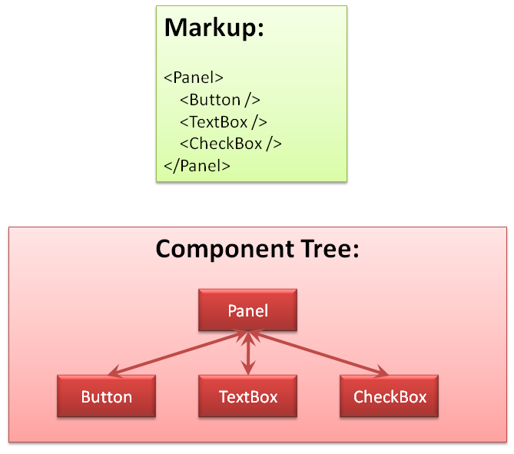
The multi-faces of the DOM
*TextBox no longer exists (it is now Label), but laziness prevented me from re-creating these slides

Slide 23
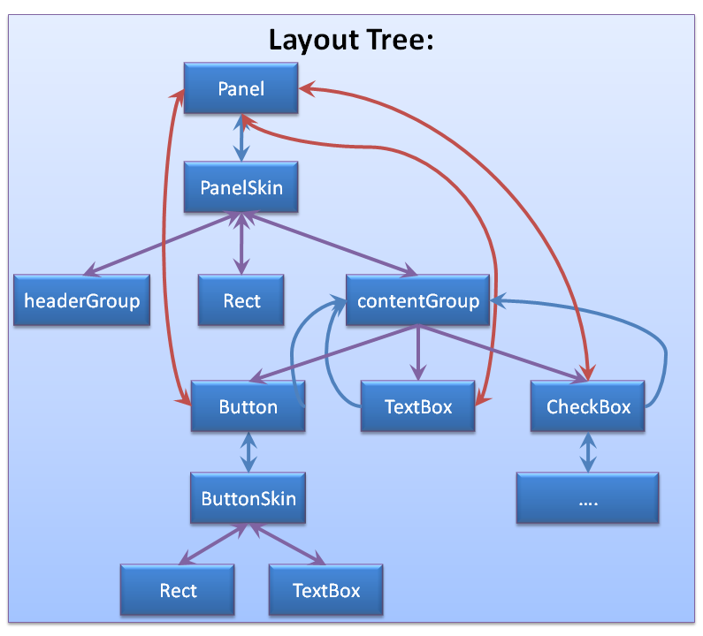
The multi-faces of the DOM
*TextBox no longer exists (it is now Label), but laziness prevented me from re-creating these slides

Slide 24
Lesser Known Features
Z-Index
  In MX Container, determined by child order
  New depth property for Spark Containers
postLayoutTransformOffsets
GroupBase.mouseEnabledWhereTransparent
GroupBase.resizeMode
GroupBase.overlay/spark.components.supportClasses.DisplayLayer

Slide 25
Internals of Group
addElementAt() handles storing the elements
elementAdded() handles adding the visual element to the DisplayList
Setting mxmlContent directly will be faster for wholesale changes, but use with caution

Slide 26
Internals of SkinnableContainers
SkinnableContainer.contentGroup
SkinnableContainer.placeHolderGroup
SkinnableContainer.mxmlContent
SkinnableContainer.mxmlContentFactory
Panel.controlBarContent

Slide 27
Container Performance Comparison
Test is 1000 empty containers
Use a Group whenever possible
SkinnableContainer can be really useful and provide a nice level of abstraction, but it is more expensive
Time (ms)
Notes:
.6 ms per group vs 1 ms per container vs 2.6 ms for skinnablecontainer

Slide 28
Performance Tip: Avoiding Nesting
One of biggest performance problems, and often one of the easiest to avoid
Example:
<s:Panel>
<s:VGroup>
<s:HGroup>
<s:Label text=“price” />
<s:Label text=“{ model.avgPrice }” />
</s:HGroup>
<s:HGroup>
<s:Label text=“User” />
<s:Label text=“{ model.firstName }” />
</s:HGroup>
</s:VGroup>
</s:Panel>

Slide 29
Performance Tip: Avoiding Reparenting
Reparenting can be expensive
  Styles have to be recreated
  Think about using includeInLayout/visible = false to hide the component instead
  See https://bugs.adobe.com/jira/browse/SDK-30875
Time (ms)

Slide 30
Questions

