Slide 1
Custom ItemRenderers
Ryan Frishberg and Joan Lafferty
MAX 360 – 11/19/08
Notes:
Ryan and Joan

Slide 2
Introduction and Resources
Grandfather to Custom ItemRenderers : Alex Harui
Additional Resources:
Alex’s Blog: http://blogs.adobe.com/aharui
Peter Ent’s Blog: http://weblogs.macromedia.com/pent
Notes:
Joan

Slide 3
Agenda
Types of ItemRenderers
Virtualization of ItemRenderers
Common Problems and Solutions
Using States, Editors, and Reusable itemRenderers.
Building for Performance
ItemRenderers in Flex 4 (Gumbo)
Notes:
Joan

Slide 4
itemRenderer
A list renders data, usually in a label
You can use item renderers to render the data however you want
itemRenderer is a property on List classes typed to take an IFactory.
<mx:List itemRenderer=“MySuperSweetItemRenderer”>
<mx:dataProvider>
…
</mx:dataProvider>
</mx:List>
Notes:
Joan
Notice itemRenderer is a className…the MXML compiler automatically wraps it in a class factory for us

Slide 5
Types of ItemRenderers
Two main types:
Custom Item Renderers
Drop-in Item Renderers (IDropInListItemRenderer)
Three ways to create them:
New ActionScript Class
New MXML Class
Inline
Notes:
Ryan

Slide 6
Custom ItemRenderers
Most basic item renderer
What developers use most of the time
Your item renderer is specific to the data you want to display.
Item renderer implements IDataRenderer
<?xml version="1.0" encoding="utf-8"?>
<mx:VBox xmlns:mx="http://www.adobe.com/2006/mxml">
<mx:Label text="{data.lastName + ', ' + data.firstName}" />
</mx:VBox>
Notes:
Ryan

Slide 7
Creating a custom item renderer
Three ways to create them:
New ActionScript Class
New MXML Class
Inline
Notes:
Ryan
Show three different, non-performant item renderers

Slide 8
Drop-in ItemRenderers
What most Flex framework components implement
Drop in item renderers implement IDropInListItemRenderer (a.k.a. – ISchemaLessListItemRenderer)
Doesn’t just give you the data property, but it gives you the listData
Why do you need this? How to create an item renderer for multiple DataGrid columns?
You can “drop in” the item render, and it’ll just display the data—no matter what the data is
Notes:
Ryan
Imagine creating a renderer for a datagrid where you want to use the same renderer for multiple columns.
The data property just gives you the data for that row. It doesn’t tell you what data you actually want to display.
The listData property gives you the columnIndex as well as the label (based on labelFunction/labelField).

Slide 9
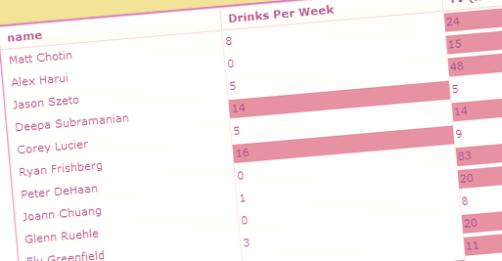
Reusable Renderers
Most itemRenderers are written to associate a renderer with a column.
<mx:Label text=“{data.firstName}” fontStyle=“italic”/>
To make an itemRenderer reusable, do not associate it with a column.
Use the listData property on your itemRenderer to determine what data you are representing.
Notes:
Joan

Slide 10
Reusable Renderers: Using listData
To use listData, your itemRenderer must implement IDropInListItemRenderer.
Components like CheckBox, Button, NumericStepper, Text and DateField already implement IDropInListItemRenderer.
Containers do not implement IDropInListItemRenderer.

Slide 11
Implementing IDropInListItemRenderer
<mx:Canvas xmlns:mx="http://www.adobe.com/2006/mxml" implements="mx.controls.listClasses.IDropInListItemRenderer“>
<mx:Script>
<![CDATA[
import mx.controls.listClasses.BaseListData;
private var _listData:BaseListData;
public function get listData() : BaseListData
{
return _listData;
}
public function set listData( value:BaseListData ) : void
{
_listData = value;
}
…
Notes:
Joan
Show backgroundColor IDropInListItemRenderer example

Slide 12
Sizing an item renderer
The explicit width of an itemRender is always the size of its container (or the column size in a datagrid)
The height of an itemRender is always rowHeight unless variableRowHeight = true (false by default)
By default, the width of a List is 200 pixels and the number of rows displayed is 7.
Reverse this for horizontal lists
Notes:
Ryan
var xx:Number = left + paddingLeft - horizontalScrollPosition;
var ww:Number = right - paddingLeft - paddingRight;
item.explicitWidth = ww;
if ((item is IInvalidating)
&& (wordWrapChanged || variableRowHeight))
IInvalidating(item).invalidateSize();
UIComponentGlobals.layoutManager.validateClient(item, true);
hh = Math.ceil(variableRowHeight ?
item.getExplicitOrMeasuredHeight() +
cachedPaddingTop + cachedPaddingBottom :
rowHeight);
rh = item.getExplicitOrMeasuredHeight();
item.setActualSize(ww, variableRowHeight ? rh : rowHeight - cachedPaddingTop - cachedPaddingBottom);
item.move(xx, yy + cachedPaddingTop);
// if we've run out of data, we dont make renderers
// and we inherit the previous row's height or rowHeight
// if it is the first row.
hh = rowNum > 0 ? rowInfo[rowNum - 1].height : rowHeight;
if (hh == 0)
hh = rowHeight;

Slide 13
Virtualization / Renderer Recycling
Column 1
Cell 1-1
Cell 2-1
Column 2
Cell 1-2
Cell 2-2
Column 3
Cell 1-3
Cell 2-3
Column 4
Cell 1-4
Cell 2-4
Cell 3-1
Cell 4-1
Cell 3-2
Cell 4-2
Cell 3-3
Cell 4-3
Cell 3-4
Cell 4-4
Column 5
Cell 1-5
Cell 2-5
Cell 3-5
Cell 4-5
Column 6
Cell 1-6
Cell 2-6
Cell 3-6
Cell 4-6
Column 7
Cell 1-7
Cell 2-7
Cell 3-7
Cell 4-7
Cell 5-1
Cell 6-1
Cell 7-1
Cell 5-2
Cell 6-2
Cell 7-2
Cell 5-3
Cell 6-3
Cell 7-3
Cell 5-4
Cell 6-4
Cell 7-4
Cell 5-5
Cell 6-5
Cell 7-5
Cell 5-6
Cell 6-6
Cell 7-6
Cell 5-7
Cell 6-7
Cell 7-7
Notes:
Ryan

Slide 14
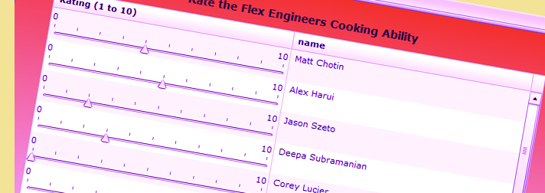
Renderers as Editors
Setting a custom itemRenderer like a CheckBox or DateField does not mean your data is saved.
List component should be editable.
Set rendererIsEditor=true.
Set editorDataField if the default property of your renderer is not “text”.
Notes:
Joan

Slide 15
Example: Slider as a Renderer and Editor
Slider does not implement IDataRenderer or IDropInListItemRenderer.
Make a custom Slider that implements IDataRenderer, IListItemRenderer and IDropInListItemRenderer.
Set editable=true, itemRenderer=“MySlider”, rendererIsEditor=“true” editorDataField=“value”
<mx:DataGridColumn
dataField="rating"
headerText="Rating (1 to 10)"
itemRenderer="MySlider"
rendererIsEditor="true"
editorDataField="value">
Notes:
Joan

Slide 16
Using States in ItemRenders
Remember row recycling. States are not saved in an itemRenderer resulting in unexpected behavior when you scroll.
The State should be associated with the data of your itemRenderer.
Reset states in your set data() methods.
Notes:
Joan

Slide 17
Resetting the state in the set data function.
override public function set data( value:Object ) : void
{
// setting the data property on the super class is required
// for any override of the set data function.
super.data = value;
if(data.expanded)
currentState="expandedState";
else
currentState="collapsedState";
}
Notes:
Joan

Slide 18
Performance
We are smart about creating itemRenderers, but there are still lots of item renderers on screen in a 20x20 datagrid.
Item renderers need to be performant because there are so many of them.
Notes:
Ryan

Slide 19
Performance: Tips for Speed
Layout’s often expensive and unnecessary for item renderers
Instead, base your renderers off of UIComponent and layout the items explicitly yourself
Developing your item renderers in MXML can be more expensive. For example, you probably don’t need to use data-binding.
Instead just use ActionScript – you know when the data is changing (data setter gets called), so there’s really no need for binding
Notes:
Ryan

Slide 20
ItemRenderers in Gumbo
Still a lot of details TBD
No virtualization support today
No IDropInListItemRenderer support yet (no labelField, labelFunction)
Not just itemRenderer property but itemRendererFunction as well
DataGroups support both Data Items and Visual Elements (perhaps won’t support Visual Element anymore, though)
Notes:
Ryan

Slide 21
Resources
Ryan’s Blog:
http://frishy.blogspot.com/
Joan’s Blog:
http://butterfliesandbugs.wordpress.com

