Slide 1


Getting Touch Events to Play Nice in Flex
Ryan Frishberg
Software Consultant, Lab49
http://www.frishy.com

Slide 2
About Me…About You
Former Flex SDK Engineer
Currently consultant at Lab49 UK

Slide 3
Flash Touch Basics
flash.ui.MultitouchInputMode
  TOUCH_POINT
  GESTURE
  NONE

Slide 4
Flash Touch Basics
flash.events.TouchEvent
  BEGIN
  END
  MOVE
touchEvent
  touchPointID
  isPrimaryTouchPoint
  pressure
  sizeX
  sizeY

Slide 5
Flash Touch Basics
flash.events.GestureEvent
  GESTURE_TWO_FINGER_TAP
flash.events.GestureTransformEvent
  GESTURE_PAN
  GESTURE_ROTATE
  GESTURE_ZOOM
  GESTURE_SWIPE
flash.events.PressAndTapGestureEvent
  PRESS_AND_TAP_GESTURE_EVENT

Slide 6
Flex Touch Basics
MultiTouch.inputMode controls what Flash events you get
UIComponent.interactionMode style controls how the Flex components respond to those events
  mx.core.InteractionMode
    TOUCH
    MOUSE
New down state for item renderers
  Down vs selected: Down shows intent to click, selected shows item selection(s). To show both in mobile, use an item renderer with a checkmark
Notes:
In Flex 4.0, the 3 main states were "normal", "hovered", and "selected".
In Flex 4.5, "down" and "downAndSelected" have been added.

Slide 7
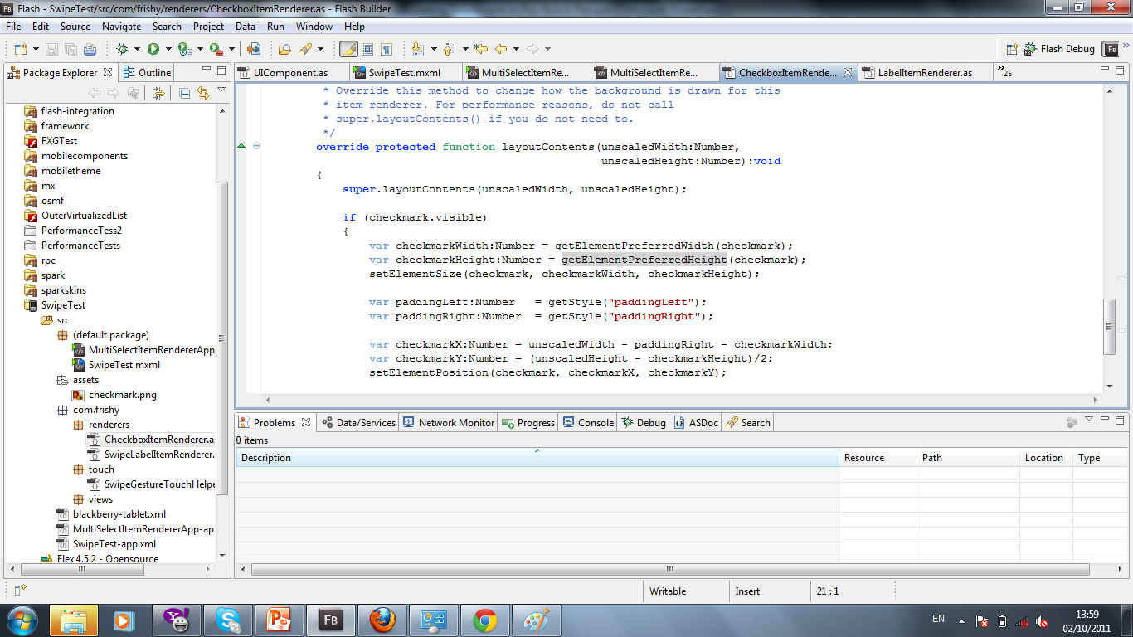
Multi-select Item Renderers Example
Notes:
In Flex 4.0, the 3 main states were "normal", "hovered", and "selected".
In Flex 4.5, "down" and "downAndSelected" have been added.

Slide 8
Why is Touch Difficult
Touch events can be inaccurate
Interactions are asynchronous and ambiguous
Who interprets what was meant?
  Components need to coordinate together

Slide 9
Button clicks in a touch-world
User presses down on a button
Are they attempting to touch the button or start scrolling?
When do we show a down state on the Button?
What if the user starts scrolling later?
What if the user presses on the button quickly – how does the user receive any feedback?

Slide 10
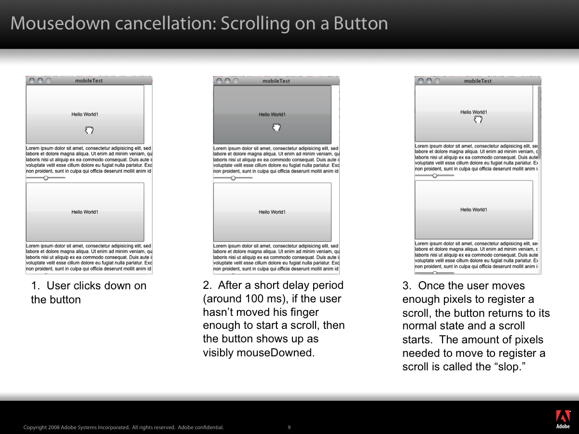

Slide 11
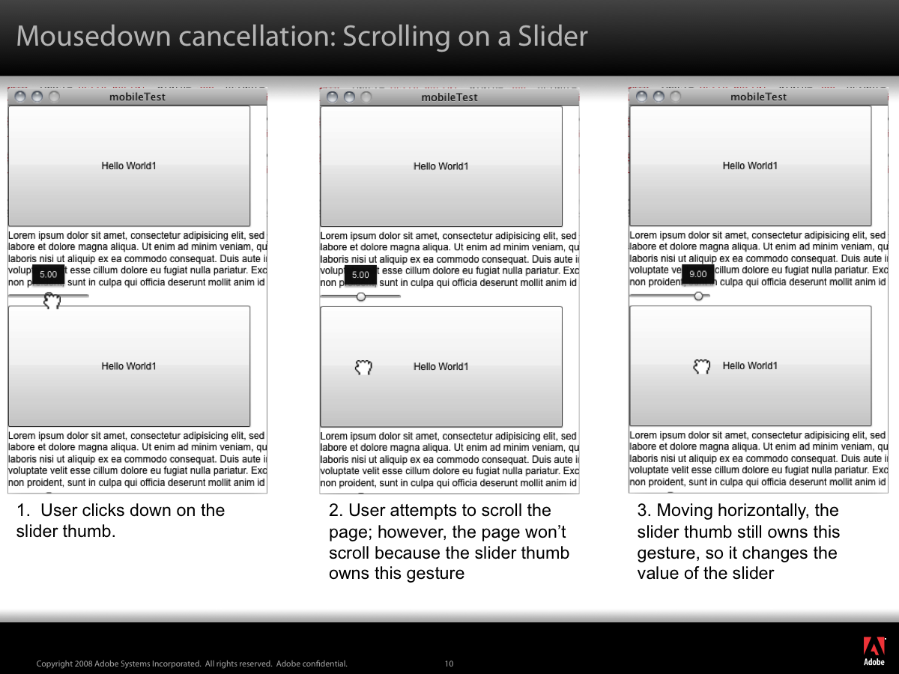

Slide 12
Touch-cancellation Behaviors
MouseEvents are bubbled up.
When a component sees a mouse event or series of mouse events they want to interpret, the component should dispatch TouchInteractionEvents
Three TouchInteractionEvents:
  STARTING, START, END

Slide 13
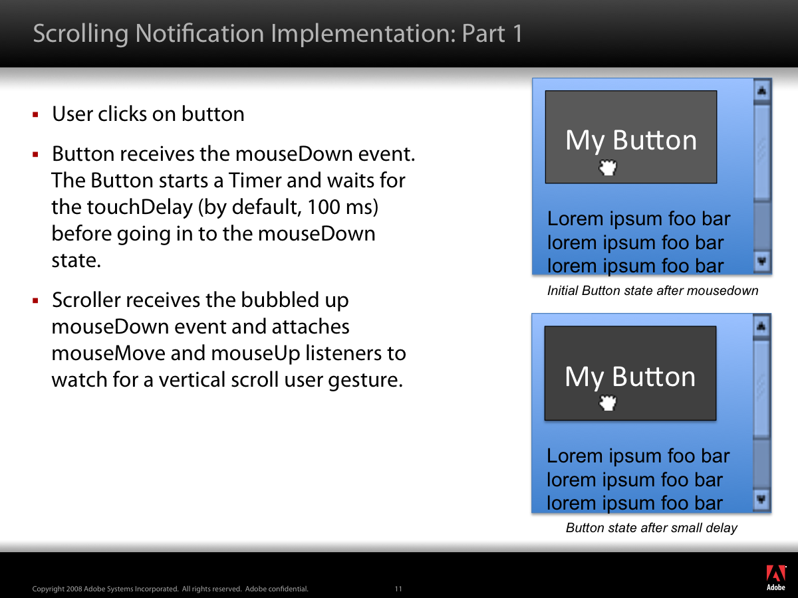

Slide 14
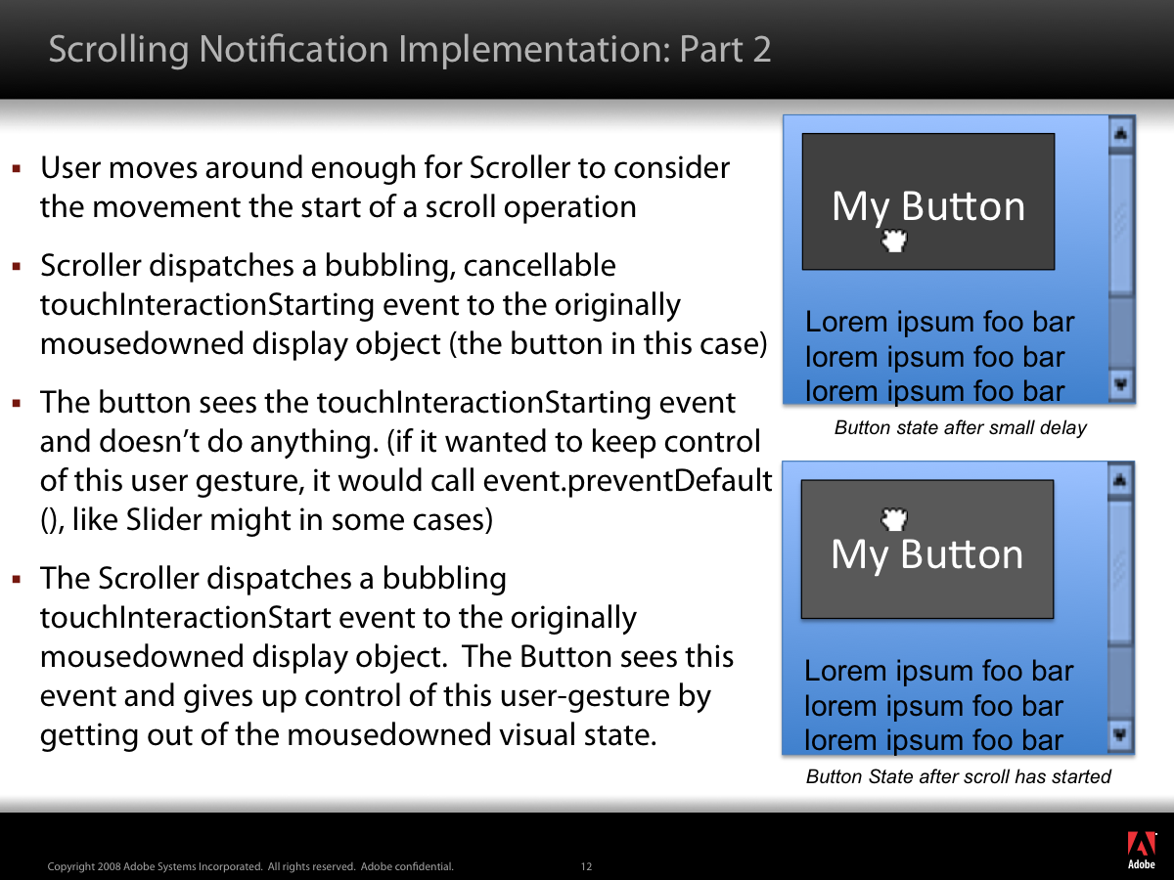

Slide 15
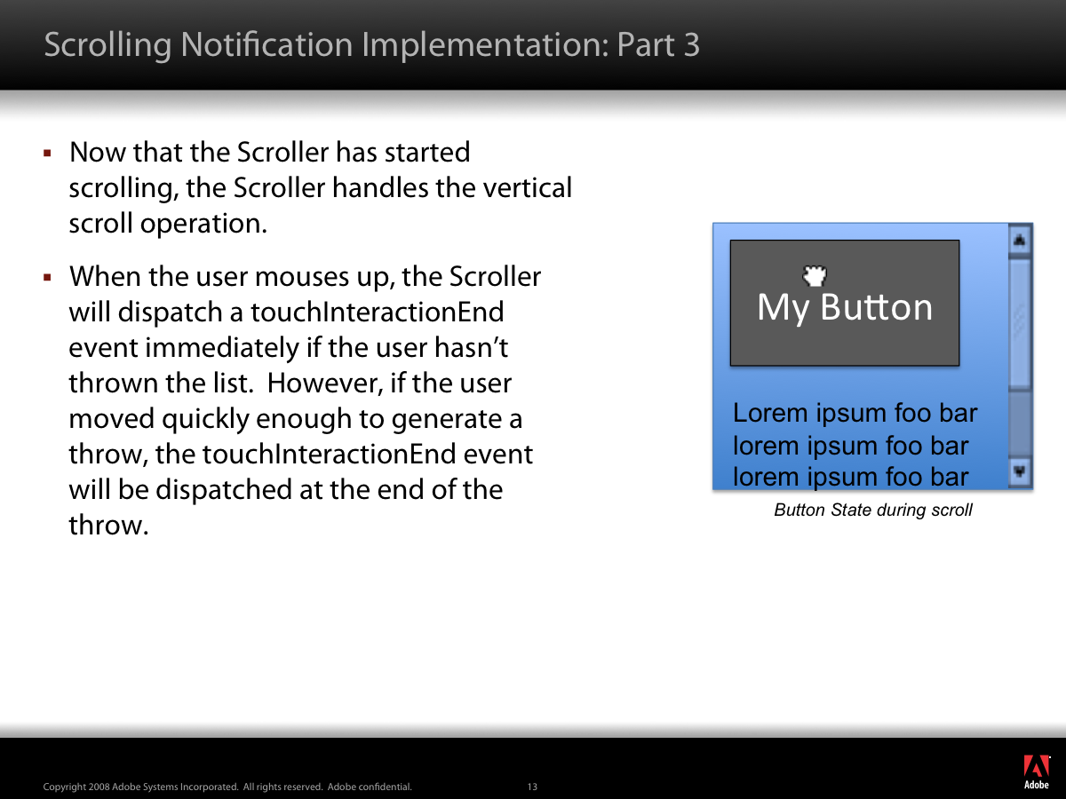

Slide 16
Buttons inside item renderers
Not just a touch issue! Issues occur with mouse as well
event.preventDefault() is your friend

Slide 17
Adding Swipe Gesture
Listen for GestureEvent
Listen for other TouchInteraction STARTs and ENDs – can’t interrupt another START
Once swipe occurs, dispatch a STARTING, and if not cancelled, dispatch a START (and then an END since it’s not asynchronous

Slide 18
Questions

